Slide 1
Fuel Fabrication
NE 591

Slide 2
Fabrication Process

Slide 3
Powder Processing
Uranium arrives at a fuel manufacturing plant in one of two forms, uranium hexafluoride (UF₆) and it needs to be converted to uranium dioxide (UO₂) prior to pellet fabrication
An example conversion process injects UF₆ into water to form a UO₂F₂ particulate slurry, ammonia (NH3) is added to this mixture and the UO₂F₂ reacts to produce ammonium diuranate (ADU, (NH₃)2U₂O₇), after which the slurry is filtered, dried and heated in a reducing atmosphere to pure UO₂
A reducing atmosphere is one in which oxidation is prevented by removal of oxygen and other oxidizing gases, and which may contain actively reducing gases such as hydrogen

Slide 4
Powder/Pellet Processing
The UO₂ powder may need further processing or conditioning before it can be formed into pellets:
Homogenization: powders may need to be blended to ensure uniformity in terms of particle size distribution and specific surface area
Additives: U₃O₈ may be added to ensure satisfactory microstructure and density for the pellets and other fuel ingredients, such as lubricants, burnable absorbers (e.g. gadolinium) and pore-formers may also need to be added
UO₂ powder is fed into dies and pressed biaxially into cylindrical pellet form using a load of several hundred MPa
Pellets are then sintered in a heating furnace
Sintering is the process of compacting and forming a solid mass of material by heat or pressure

Slide 5
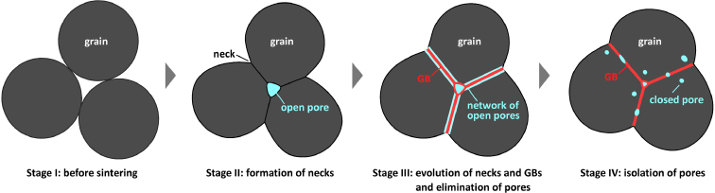
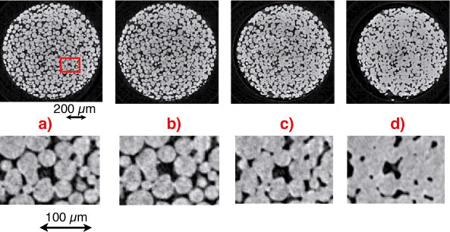
Sintering Process
During sintering, atoms in the materials diffuse across the boundaries of the particles, fusing the particles together and creating one solid piece
The final fuel pellets are nearly fully dense with a uniform microstructure: grain size ~ 10 μm; pore size ~ 3 μm; density ~ 95 - 99%
A single pellet in a typical reactor yields about the same amount of energy as one ton of coal

Slide 6
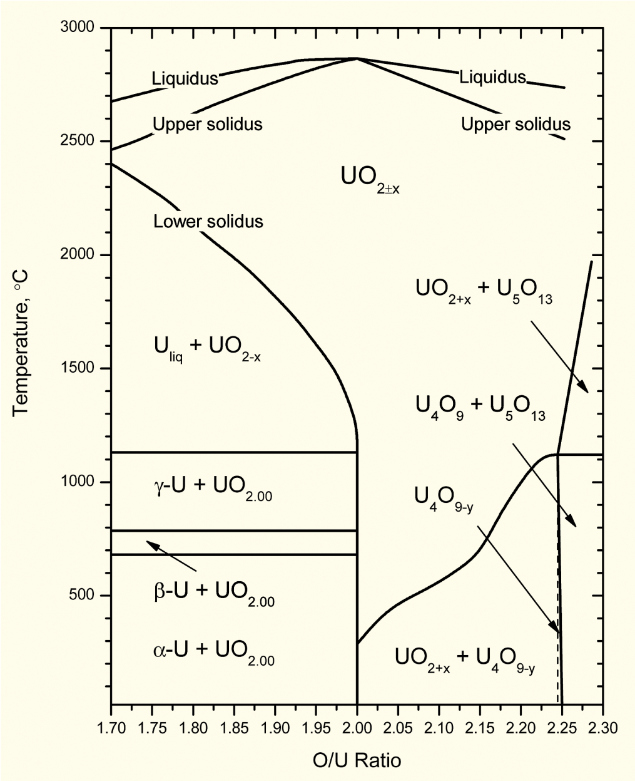
Fuel strictly manufactured to be UO₂
Fuel fabricated to be nearly stoichiometric; i.e., UO_{2.00±}
Structure stable to T_{melt}
Maximum T_{melt}
O/M ratio varies slightly during irradiation
Large deviations from stoichiometry relevant to
Fabrication
Defected fuel behavior
Reprocessing
Accident conditions during dry storage or shipment of used nuclear fuel

Slide 7
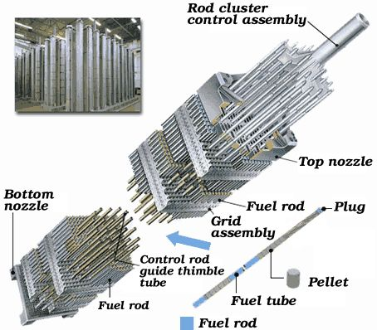
Rods and Assemblies
The fuel pellets are assembled in fuel rods and then put together in fuel assemblies
Designs dictate that the pellet-filled rods have a precise physical arrangement in terms of their lattice pitch (spacing), and their relation to other features such as water (moderator) channels and control-rod channels
Physical structures for holding the fuel rods are therefore engineered with extremely tight tolerances and are largely constructed of steel and zirconium alloys

Slide 8
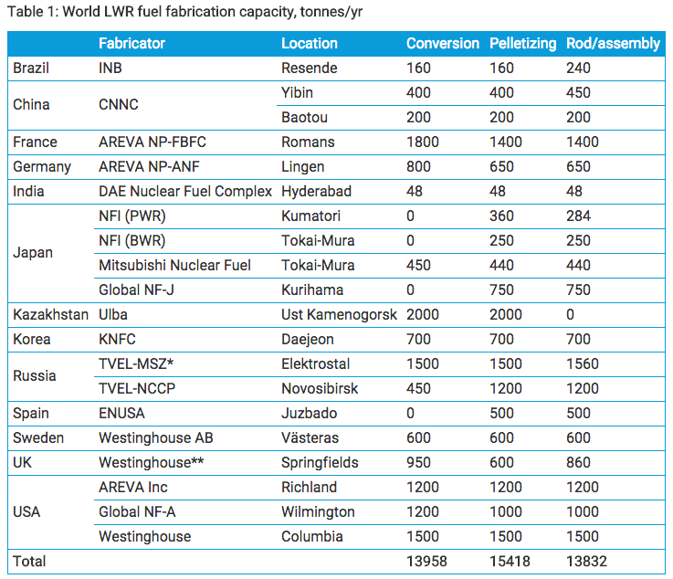
Global Fuel Fabrication
Uranium is mined and converted into fuel in a number of countries
USA, Russia, Kazakhstan and France are leaders
Is a growing need for HALEU
High assay low enriched uranium
Uranium with 19.7% enrichment

Slide 9
Fuel Fabrication Summary
Mining -> Processing -> Conversion -> Enrichment -> Powder -> Compaction/Sintering -> Rod/Assembly
U₃O₈ must be converted to UF₆ for enrichment, which is then converted to UO₂ powder for pellet manufacture
For different fuel types, enriched UF₆ follows a different path

Slide 10
Heat Transport

Slide 11
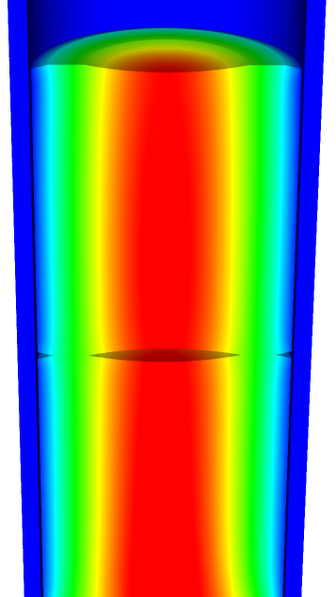
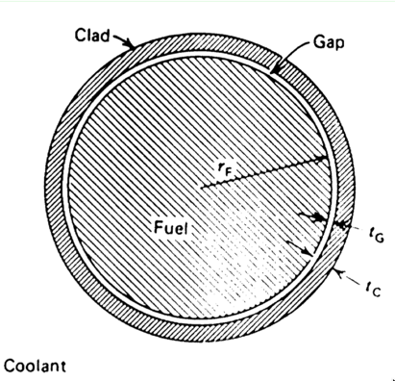
Heat transport route
Heat is produced in the fuel, transports through the cladding and gap, and into the coolant
Important quantities include
Volumetric heat generation rate Q (W/cm³)
Fuel Centerline temperature T₀
Surface temperature of the fuel T_{S}
Inner cladding temperature T_{CI}
Outer cladding temperature T_{CO}
Coolant temperature T_{cool}
Pellet radius r_{F}
Gap thickness t_{G}
Cladding thickness t_{c}

Slide 12
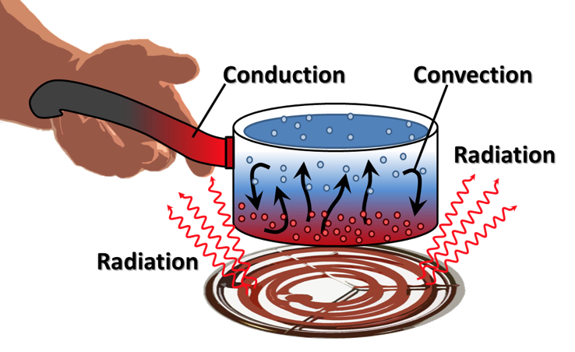
Heat can be transported in three ways
Convection
Heat transfer through mass movement of liquid or gas
Radiation
Heat transfer by means of photons in electromagnetic waves
Conduction
Heat transfer by molecular or atomic motion

Slide 13
Heat transfer mode in fuel systems?
How is heat transported through the fuel?
Conduction
How is the heat transported through the gap?
Mostly conduction, some convection
How is heat transported through the cladding?
Conduction
How is heat transported to the coolant?
Convection

Slide 14
Heat conduction equation
ρ is the density, c_{p} is the specific heat, T is the temperature, t is the time, and k is the thermal conductivity
It is a partial differential equation in time and space
We are solving for the T as a function of space and time
T(x, t), where x is a vector defining the position in space
What do we need to know to solve this equation?
The geometry of our problem
The initial condition of T
The boundary conditions of T
Is each parameter is a function of T
If they aren’t a function of T, do they vary in space and time for some other reason?

Slide 15
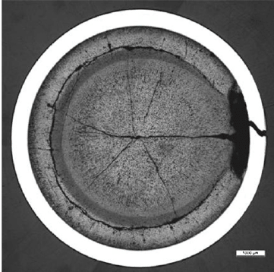
What is our geometry for the problem?
Reactor geometry depends on reactor type
The ideal geometry of each fuel rod is axisymmetric, but in reality it is 3D
Fuel pellet defects cause 3D geometry
The stacked pellets may not be stacked perfectly, causing their center axis to not be aligned, also causing 3D geometry

Slide 16
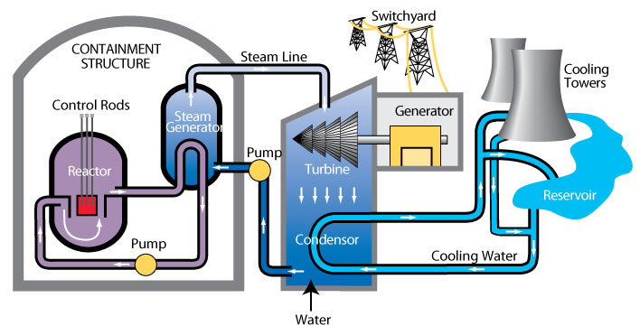
The initial condition of T
The initial condition of T is set by the state of the reactor directly before startup
What is the initial temperature profile of the fuel?
The initial temperature is uniform throughout the fuel
It is equal to the initial coolant temperature
T(x, 0) = T_{cool}(0)

Slide 17
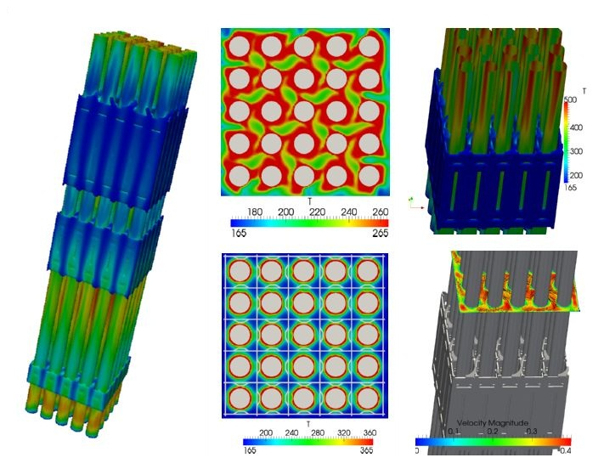
Boundary conditions?
The boundary conditions on T is set by the coolant flow
The temperature of the coolant T_{cool} is complicated
It varies along the length of the fuel rod (axially)
It various around the circumference of the fuel rod

Slide 18
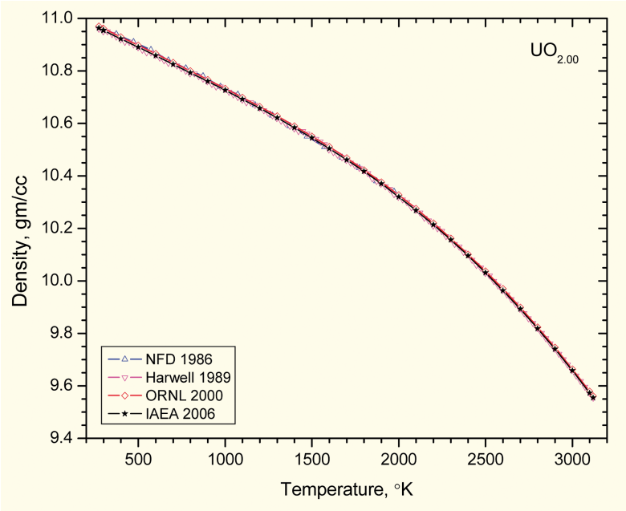
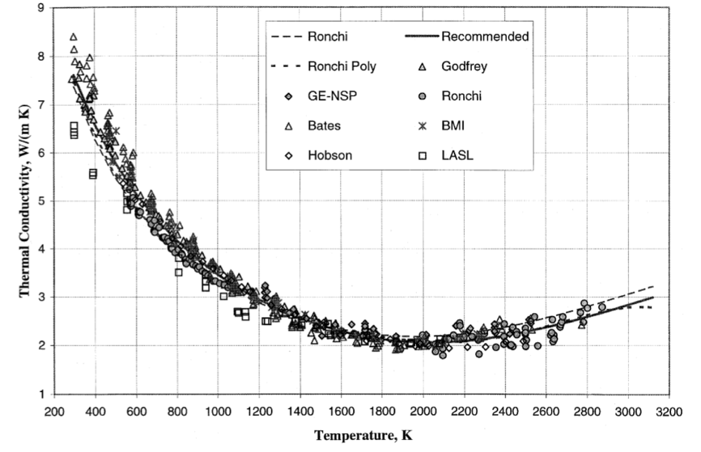
Fuel properties
Density varies as a function of T (thermal expansion)
Also varies as a function of composition (thus as a function of burnup/time)
Thermal conductivity also varies with temperature

